Slide 1
Cause of death analysis
Presented by
Lavina vaidya

Slide 2
contents
Introduction
Business problem framing
Review Of literature
Model/s visualization and evaluation
Conclusion
Limitations of this work
Scope for future work
References

Slide 3
Introduction
Cause of Death is a term used to indicate the medical cause of death. It lists the disease(s) or injuries that caused death. Specific cause of death information is recorded on the death certificate and is entered into the Vital Statistics System.
The cause of death is defined as the disease or injury which started the train (sequence) of morbid (disease-related) events which led directly to death, or the circumstances of the accident or violence which produced the fatal injury.

Slide 4
BUSINESS PROBLEM FRAMING
The business problem of cause of death is to identify the root causes of death and develop strategies to prevent it. This includes understanding the factors that contribute to death, such as lifestyle, environmental, and medical conditions. It also involves understanding how different populations are affected by specific causes of death and developing strategies to reduce morbidity and mortality. This could include identifying disparities in access to care, developing preventive health initiatives, and improving public health infrastructure

Slide 5
Review Of literature
The literature on cause of death analysis provides insights into many aspects of mortality, from the leading causes of death. The literature also covers the underlying causes of death, such as genetic and environmental factors, as well as the impact of different diseases.
To review this literature following steps are done to analyse
Importing required libraries
Loading dataset
Checking null values
Checking for white space
Visualization
conclusion

Slide 6
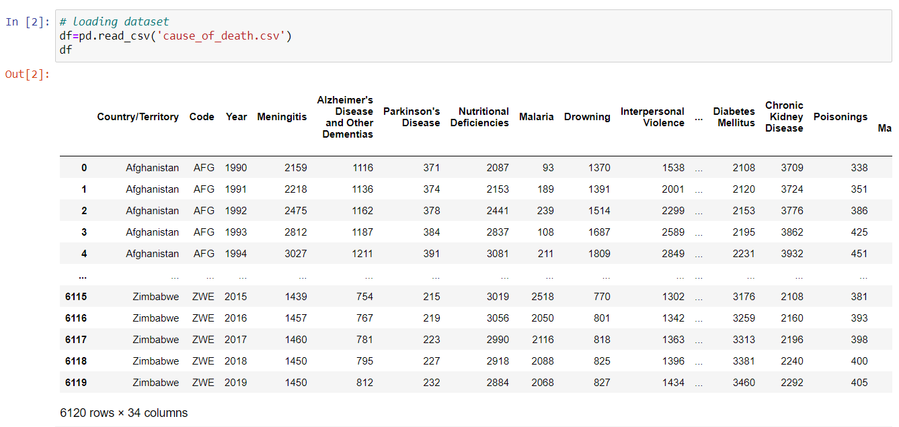
Model/s visualization and evaluation
Loading a dataset

Slide 7

Shape of dataset

Slide 8
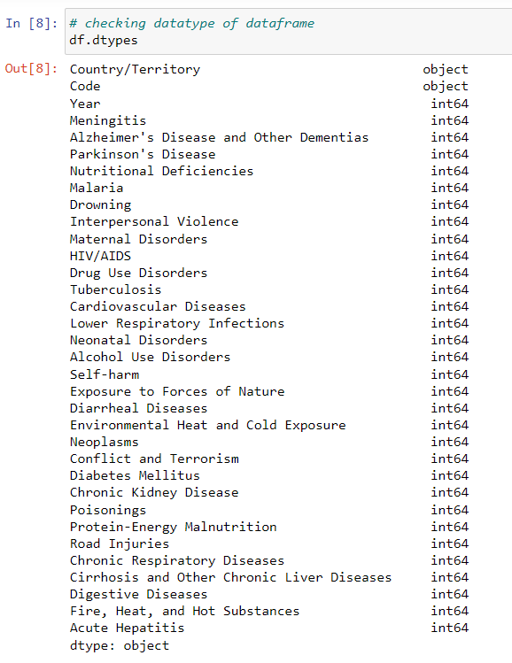
Checking for datatype

Slide 9
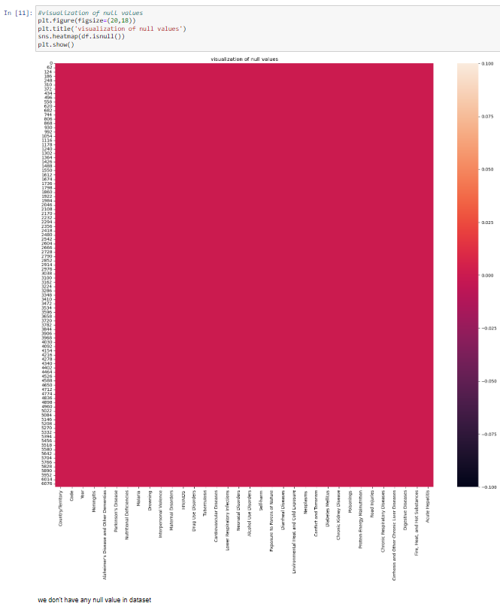
Checking for null values

Slide 10
HARDWARE AND SOFTWARE REQUIREMENTS AND TOOLS USED
Hardware required:
• Processor: core i5 or above
• RAM: 8 GB or above
• ROM/SSD: 250 GB or above
Software required:
• Anaconda 3- language used Python3

Slide 11
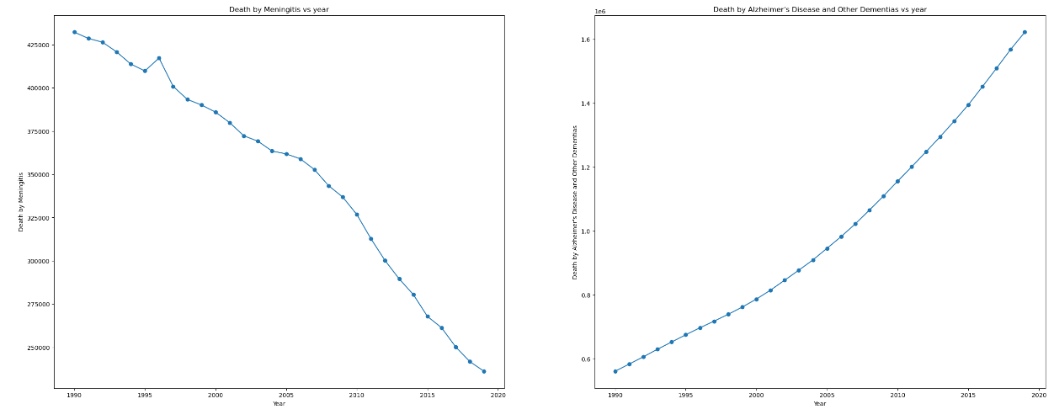
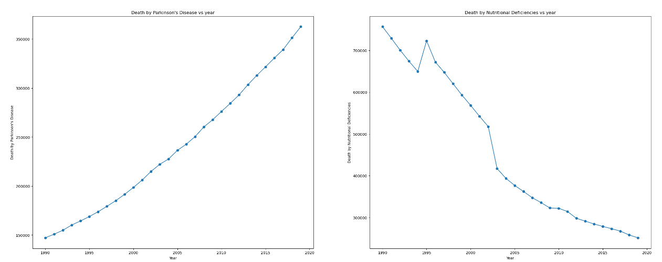
Observation:
Except for 1996, when the death rate climbed over the year before, meningitis-related deaths are declining. in 1990 more than 42500 death were recorded which is high death record.
Death by Alzheimer's Disease and Other Dementias death rates are rising year over year.
Parkinson's disease death rates are rising year over year. more than 350000 deaths were recorded in 2019 which is high death record
Deaths caused by nutritional deficiencies are on the decline, although overall death rates are rising slowly in 1995. and in 1990 high record in death recorded which is more than 700000.

Slide 12
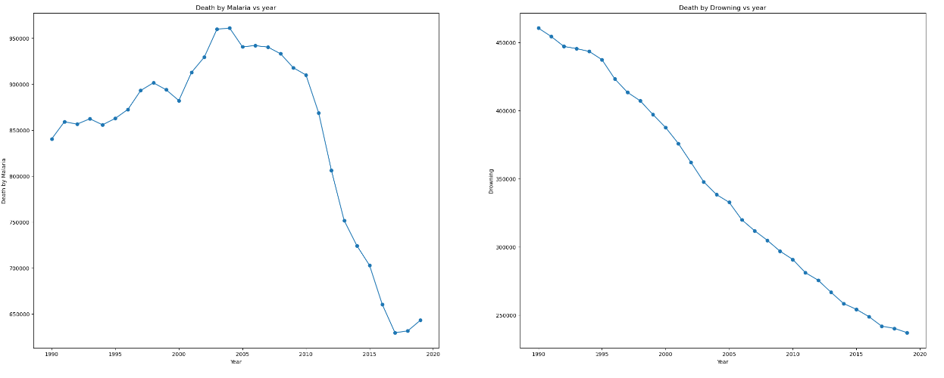
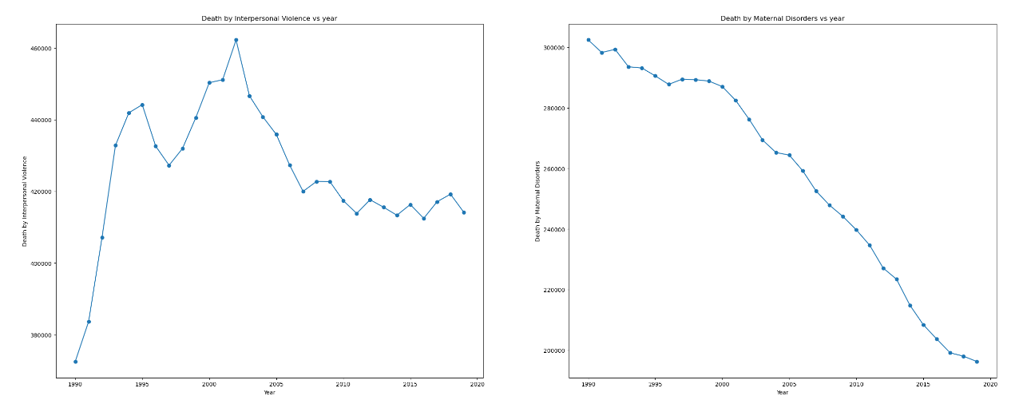
Observation:
in year 2003 and 2004 deaths by malaria is increased,which is reported by highest deaths of malaria after that deaths are gradually decreased but from 2017 death rate is increasing
death by drowing is decreases by year over year and highest death recorded in 1990
Death by Interpersonal Violence is high in 2003
Death by Maternal Disorders is decreases by year over year highest death recorded in 1990

Slide 13
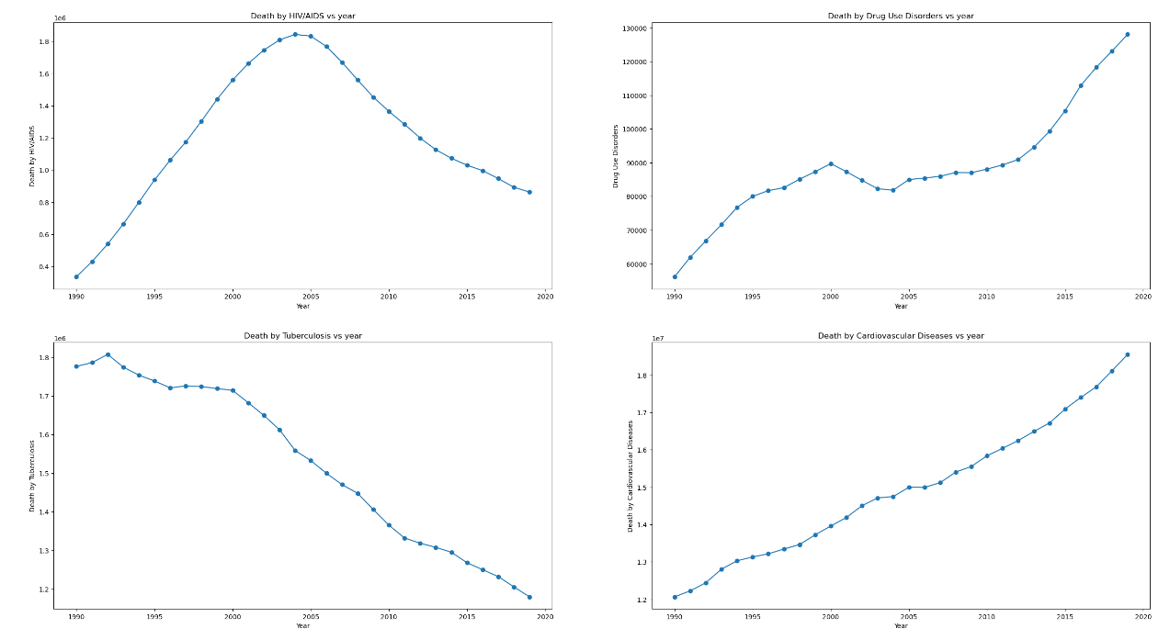
Observation:
Death by HIV/AIDS is increases from 1990 year over year, but we observed that deaths are decreases from 2004 which recorded as highest death year.
2. we observed that Death by Drug Use Disorders is increased upto 2000 then fall in record observed upto 2005 and then again high increase record observed and highest death record in 2019.
3. Death by Tuberculosis decrease year over year and highest death record in 1992 .
4. Death by Cardiovascular Diseases increases year over year and highest death record in 2019.

Slide 14
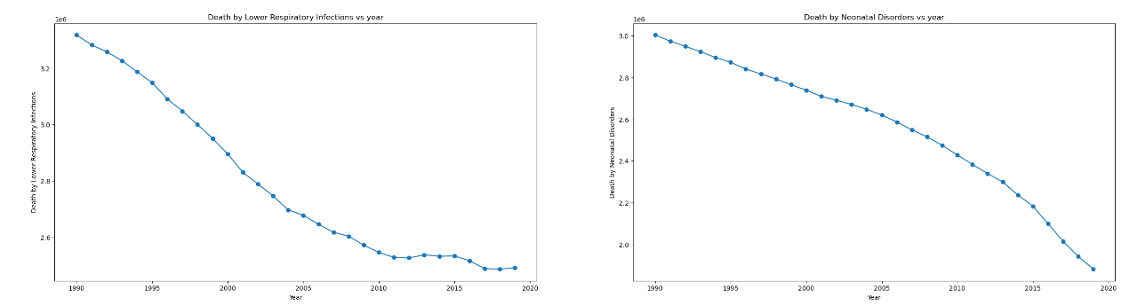
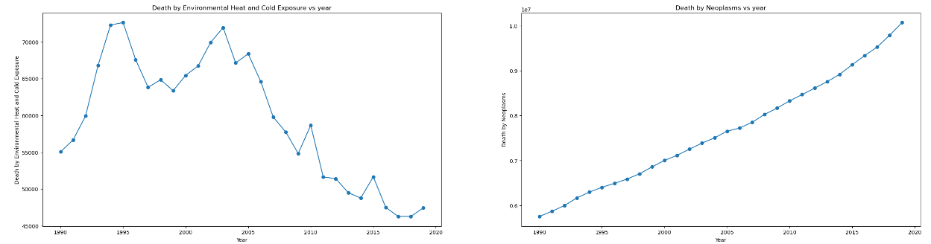
Observation:
Death by Lower Respiratory Infections decrease year over year and highest death record in 1990.
Death by Neonatal Disorders decrease year over year and highest death record in 2019.
Death by Environmental Heat and Cold Exposure is unstable and recorded high in 1995
Death by Neoplasms increases year over year and recorded high in 2019.

Slide 15
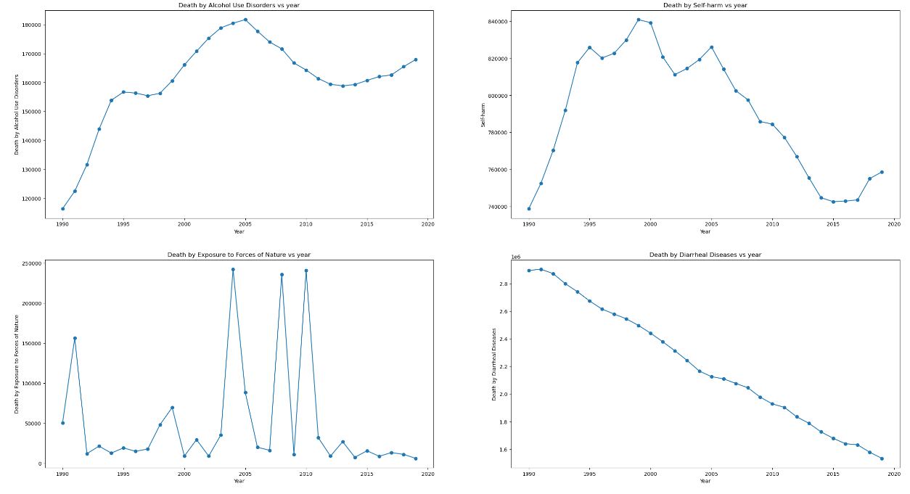
Observation:
Death by Alcohol Use Disorders increases from 1990 and scores high in 2005 but after 2005 there is decrease in death rate
Death by Self-harm is highly unstable and recorded high in 1999
Death by Exposure to Forces of Nature is highly unstable and recorded high in 2004, 2008 and 2010
Death by Diarrheal Diseases decreses gradually and recorded high in 1991

Slide 16
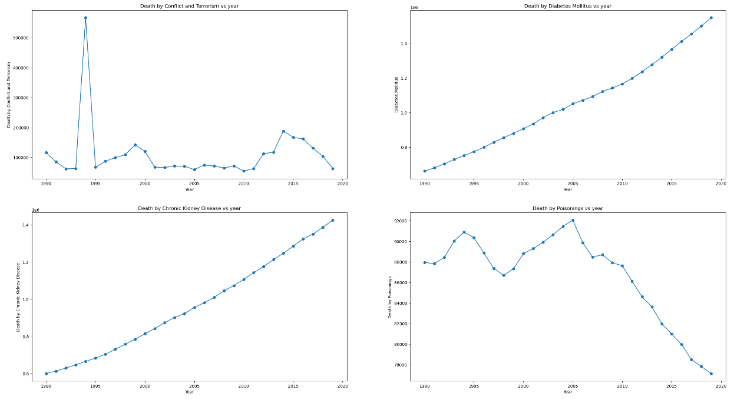
Observation:
Death by Conflict and Terrorism is highly unstable and recorded very high rate in 1994
Death by Diabetes Mellitus is increases year over year and recorded high in 2019
Death by Chronic Kidney Disease is increases year over year and recorded high in 2019
Death by Poisonings is unstable and recorded high in 2005

Slide 17
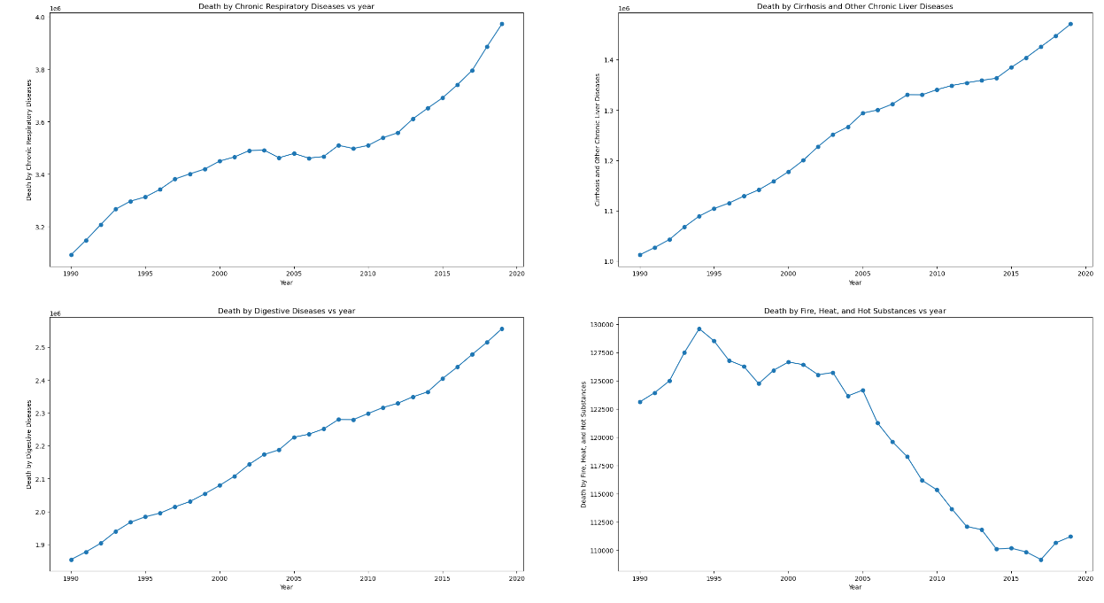
Observation:
1. Death by Chronic Respiratory Diseases increases year over year and recorded high in 2019
2. Death by Cirrhosis and Other Chronic Liver Diseases increases year over year and recorded high in 2019
3. Death by Digestive Diseases increases year over year and recorded high in 2019
4. Death by Fire, Heat, and Hot Substances is highly unstable and recorded high in 1994

Slide 18
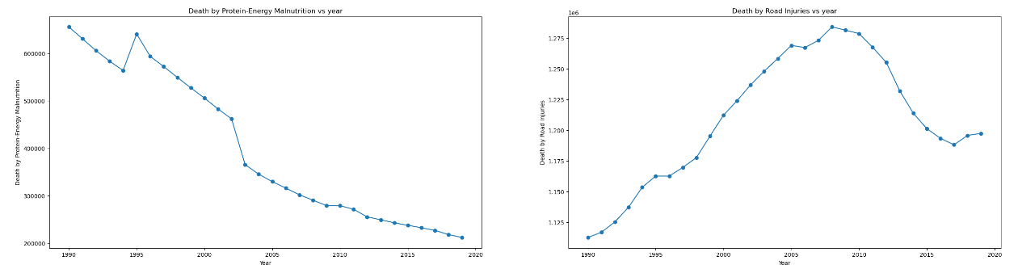
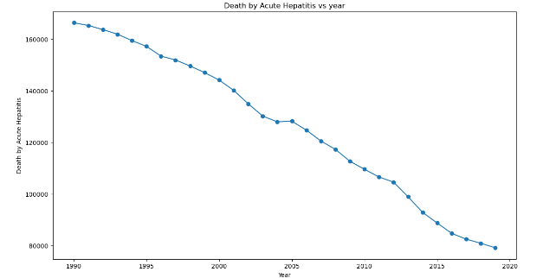
Observation:
Death by Protein-Energy Malnutrition is decreases and recorded high in 1990
2. Death by Road Injuries increases year over year upto 2008 which recorded as high rate after that it decreases gradually
Death by Acute Hepatitis decreses year over year and recorded high in 1990

Slide 19
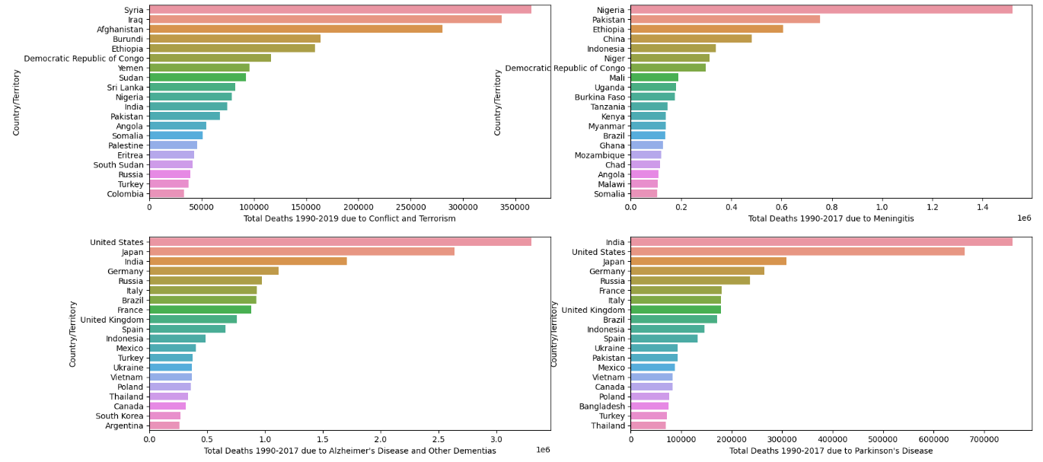
VISUALIZATION OF TOP 10 COUNTRY WITH HIGH DEATH RATE
Observation:
Total Death due to Conflict and Terrorism is high in Syria followed by Iraq
Total Death due to Meningitis is high in Nigeria followed by Pakistan
Total Death due to Alzheimer's Disease and Other Dementias is high in United State followed by Japan
Total Death due to Parkinson's Disease is high in India followed by United State

Slide 20
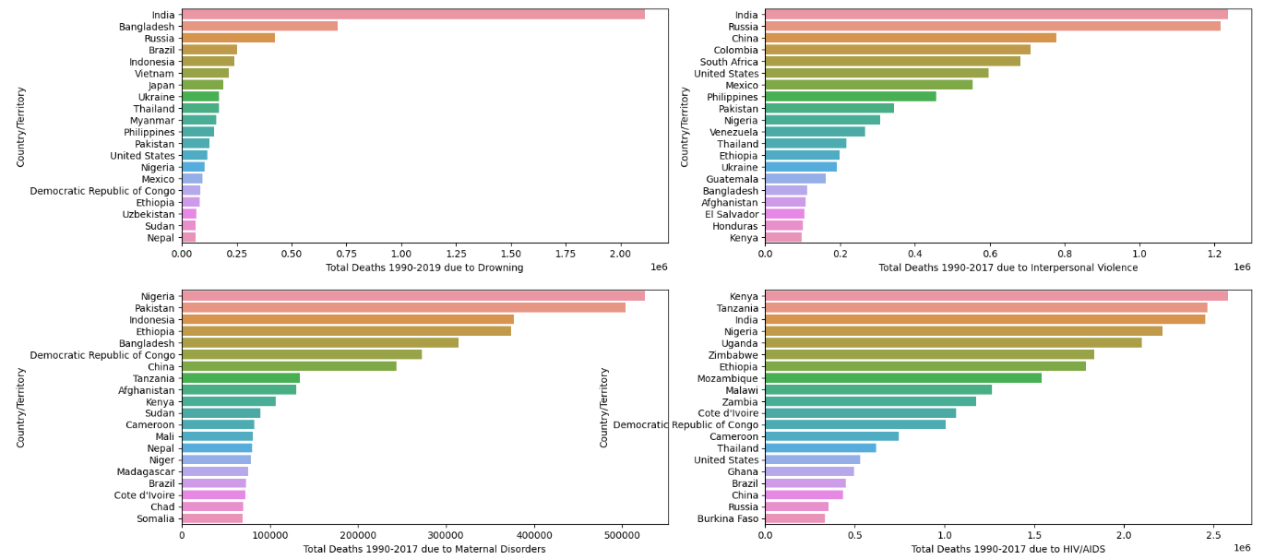
Observation:
Total Death due to Drowning is high in India followed by Bangladesh
Total Death due to Interpersonal Violence is high in India followed by Russia
Total Death due to Maternal Disorders is high in Nigeria followed by Pakistan
Total Death due to HIV/AIDS is high in Kenya followed by Tanzaia and India

Slide 21
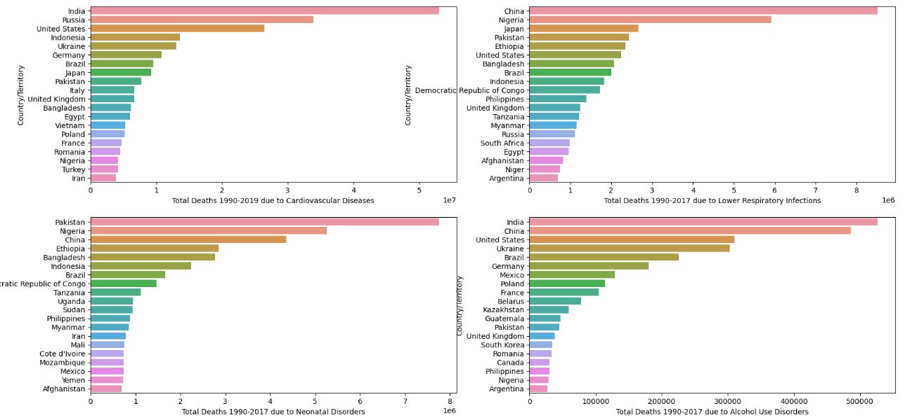
Observation:
Total Death due to Cardiovascular Diseases is high in India followed by Russia
Total Death due to Lower Respiratory Infections is high in China followed by Nigeria
Total Death due to Neonatal Disorders is high in Pakistan followed by Nigeria
Total Death due to Alcohol Use Disorders is high in India followed by China, United State

Slide 22
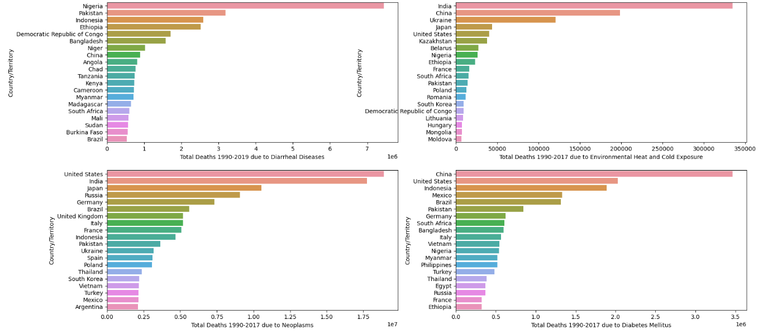
Observation:
Total Death due to Diarrheal Diseases is high in Nigeria followed by Pakistan
Total Death due to Environmental Heat and Cold Exposure is high in India followed by China
Total Death due to Neoplasms is high in United State followed by Japan
Total Death due to Diabetes Mellitus is high in China followed by United State

Slide 23
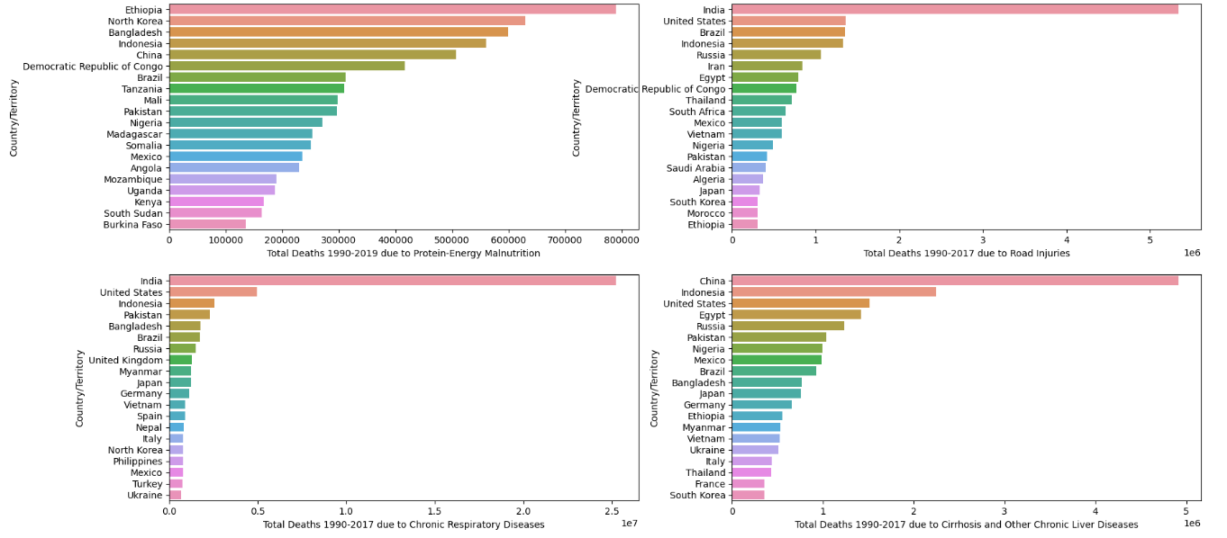
Observation:
Total Death due to Protein-Energy Malnutrition is high in Ethopia followed by North korea
Total Death due to Road Injuries is high in India followed by United State
Total Death due to Chronic Respiratory Diseases is high in India followed by United State
Total Death due to Cirrhosis and Other Chronic Liver Diseases is high in China followed by Indonesia

Slide 24
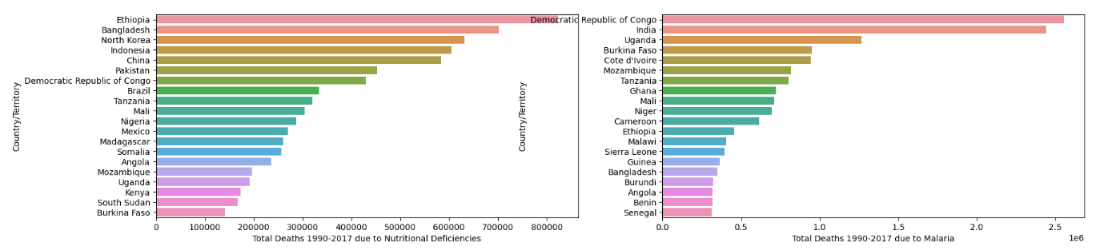
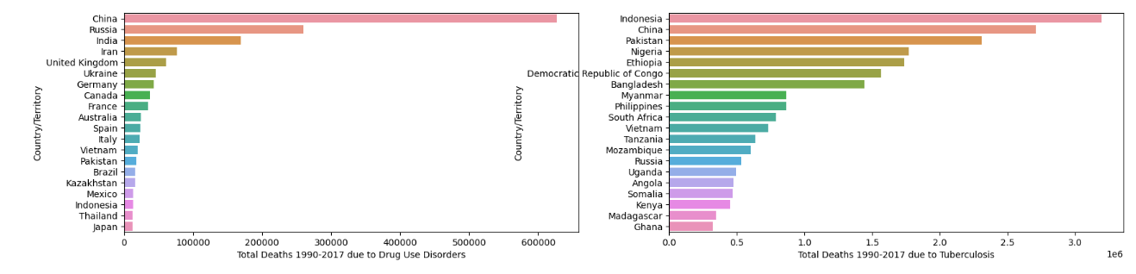
Observation:
Total Death due to Nutritional Deficiencies is high in Ethopia followed by Bangladesh
2. Total Death due to Malaria is high in Republic of congo followed by India
Total Death due to Drug Use Disorders is high in China followed by Russia
Total Death due to Tuberculosis is high in Indonesia followed by China

Slide 25
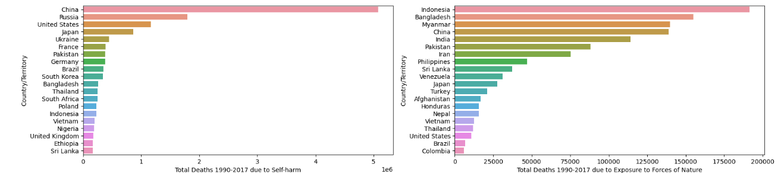
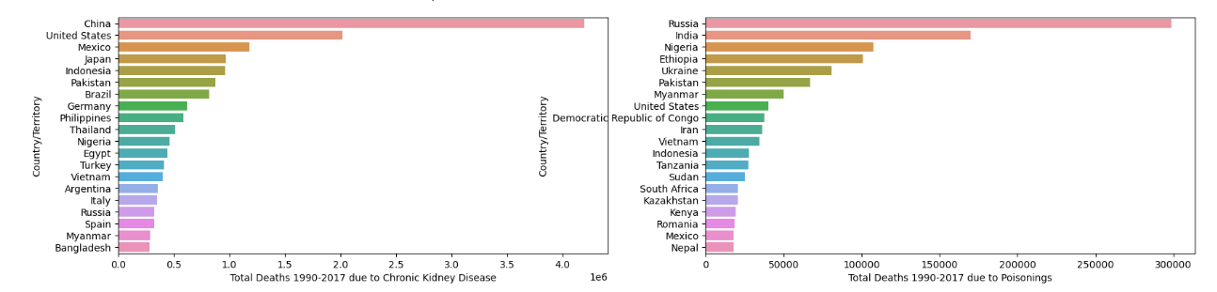
Observation:
Total Death due to Self-harm is high in China followed by Russia
Total Death due to Exposure to Forces of Nature is high in Indonesia followed by Bangladesh
Total Death due to Chronic Kidney Disease is high in China followed by United State
Total Death due to Poisonings is high in Russia followed by India

Slide 26
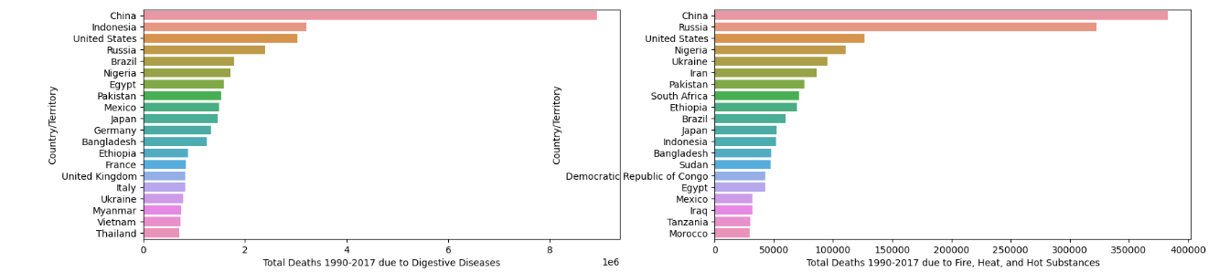
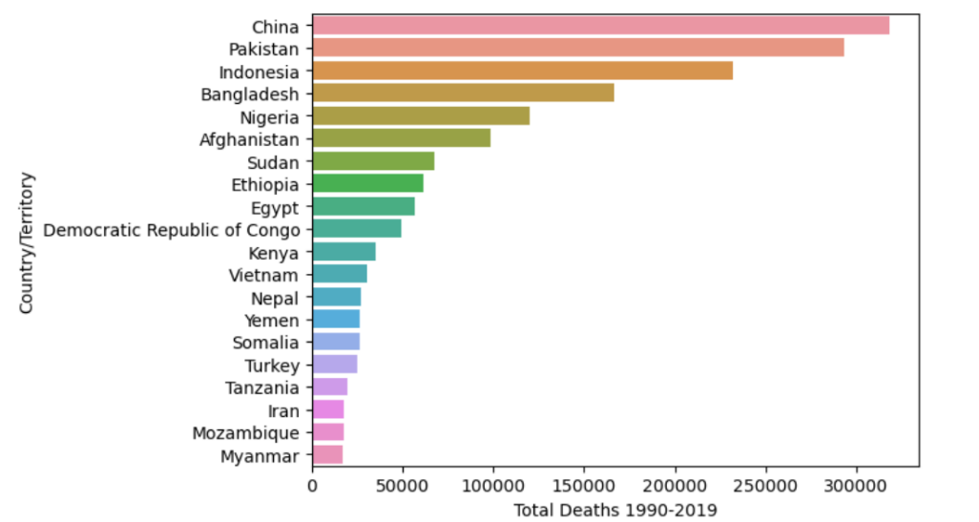
Observation:
Total Death due to Digestive Diseases is high in China followed by Indonesia
Total Death due to Fire, Heat, and Hot Substances is high in China followed by Russia
total death due to Total Deaths is high in china followed by pakistan, indonesia

Slide 27
CONCLUSION
1. India : Death rate is high due to Chronic Respiratory Diseases, Environmental Heat and Cold Exposure, Neoplasms, Cardiovascular Diseases, Alcohol Use Disorders, Parkinson's Disease, Malaria, Drowning, Interpersonal Violence, HIV/AIDS.
2. Pakistan : Death rate is high due to Acute Hepatitis, Diarrheal Diseases, Neonatal Disorders, Maternal Disorders, Tuberculosis, Meningitis.
3. Indonesia : Death rate is high due to Acute Hepatitis, Cirrhosis and Other Chronic Liver Diseases, Digestive Diseases, Diarrheal Diseases, Exposure to Forces of Nature, Tuberculosis, Nutritional Deficiencies.
4. China : Death rate is high due to Acute Hepatitis, Cirrhosis and Other Chronic Liver Diseases, Digestive Diseases,Fire, Heat, and Hot Substances, Chronic Kidney Disease, Environmental Heat and Cold Exposure, Diabetes Mellitus, Lower Respiratory Infections, Alcohol Use Disorders, Self-harm, Nutritional Deficiencies, Tuberculosis, Drug Use Disorders, Interpersonal Violence.

Slide 28
5. United state : Death rate is high due to Alzheimer's Disease and Other Dementias, Parkinson's Disease, Cardiovascular Diseases, Self-harm, Neoplasms, Diabetes Mellitus, Road Injuries, Chronic Respiratory Diseases, Cirrhosis and Other Chronic Liver Diseases, Digestive Diseases, Fire, Heat, and Hot Substances
6. Ethopia : Death rate is high due to Protein-Energy Malnutrition, Diarrheal Diseases, Neonatal Disorders, Tuberculosis, Maternal Disorders, Nutritional Deficiencies, Meningitis, Conflict and Terrorism.
7. Russia : Death rate is high due to Fire, Heat, and Hot Substances, Digestive Diseases, Cirrhosis and Other Chronic Liver Diseases, Road Injuries, Neoplasms, Poisonings, Self-harm, Cardiovascular Diseases, Alzheimer's Disease and Other Dementias, Parkinson's Disease, Interpersonal Violence, Drowning
8. North Korea : Death rate is high due to Nutritional Deficiencies, Protein-Energy Malnutrition.

Slide 29
9. Nigeria : Death rate is high due to Fire, Heat, and Hot Substances, Digestive Diseases, Diarrheal Diseases, Poisonings, Meningitis, HIV/AIDS, Neonatal Disorders.
10. Bangladesh : Death rate is high due to Acute Hepatitis, Nutritional Deficiencies, Drowning, Maternal Disorders, Neonatal Disorders, Exposure to Forces of Nature, Protein-Energy Malnutrition, Chronic Respiratory Diseases
11. Mexico : Death rate is high due to Chronic Kidney Disease, Diabetes Mellitus.
12. Japan : Death rate is high due to Chronic Kidney Disease, Neoplasms, Self-harm, Lower Respiratory Infections, Alzheimer's Disease and Other Dementias, Parkinson's Disease, Drowning, Cardiovascular Diseases.
13. Ukraine : Death rate is high due to Cardiovascular Diseases, Alcohol Use Disorders, Drug Use Disorders, Environmental Heat and Cold Exposure, Self-harm.
14. Kenya : Death rate is high due to HIV/AIDS
15. South Africa : Death rate is high due to Interpersonal Violence.

Slide 30
16. Democratic republic of congo : Death rate is high due to Nutritional Deficiencies, Maternal Disorders, Conflict and Terrorism, Tuberculosis, Poisonings, Protein-Energy Malnutrition, Diarrheal Diseases.
17. Syria : Death rate is high due to Conflict and Terrorism,
18. Tanzania : Death rate is high due to HIV/AIDS, Malaria, Acute Hepatitis

Slide 31
LIMITATIONS OF THIS WORK
The main limitation of course of death analysis is that it does not take into account other factors that can contribute to death, such as lifestyle and environmental factors. Additionally, it does not consider the potential for misclassification of cause of death. Furthermore, it does not consider the effect of different treatments on mortality.

Slide 32
SCOPE FOR FUTURE WORK
The scope for future work in this area could include further analysis of the role of lifestyle and environmental factors in mortality, as well as the potential for misclassification of cause of death. Additionally, further research could be done on the effects of various treatments on mortality. Additionally, more research could be done to understand the impact of social determinants of health on mortality.
Finally, further research could be done to better understand the impact of specific conditions and treatments on mortality

Slide 33
REFERENCES
https://ec.europa.eu/eurostat/statistics-explained/index.php?title=Glossary:Cause_of_death#:~:text=The%20cause%20of%20death%20is,which%20produced%20the%20fatal%20injury.
https://snohomishcountywa.gov/806/Cause-Manner-of-Death
https://www.kaggle.com/code/spscientist/a-simple-tutorial-on-exploratory-data-analysis
https://en.wikipedia.org/wiki/Exploratory_data_analysis#:~:text=In%20statistics%2C%20exploratory%20data%20analysis,and%20other%20data%20visualization%20methods

